Slide 1
Waynbo
By Papersoft

Slide 2
Topic
Intro
Our goals
How Mojaloop helped
Prototype / Demo
Major concerns to address

Slide 3
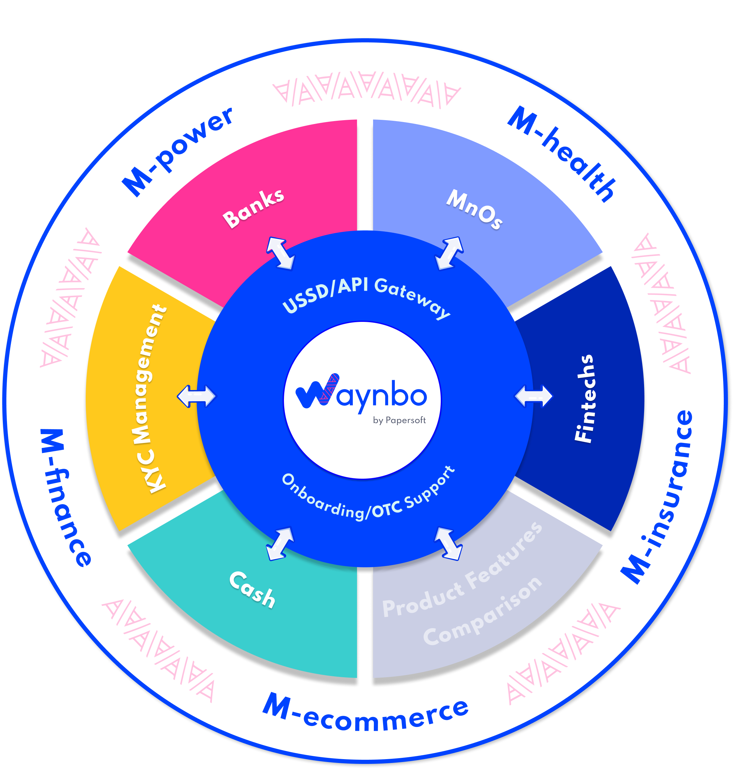

Team
Waynbo by Papersoft aggregates, automate and secures CICO, transfer, bill payment and bookkeeping operations for Mobile Money and Bank agents on a single app without requiring internet connection.
Business accounts allow agent network managers to support operations, performance, and coordinate liquidity needs. Fintech's and DFSs can join the open-network by uploading their services as mini-apps.
Currently LIVE in Nigeria and Mozambique.
The Goal
We wanted to explore how an instant payment switch could boost agents revenue streams and understand the impact on our business model.
It needed to operate independent of DFS lock-ins, be seamless and securely built for purpose for last mile customers and support liquidity.
The Prototype
We have built a new service in the agent super app to accommodate this challenge.
Customers generate a one-time code and share with others to pick-up cash at an agent point where liquidity is currently available.
How Moojaloop helped
We have used Mojaloop infrastructure to transfer from customer account to agent independent of the DFS leveraging instant payment switch and customer OTP authentication.

Slide 4
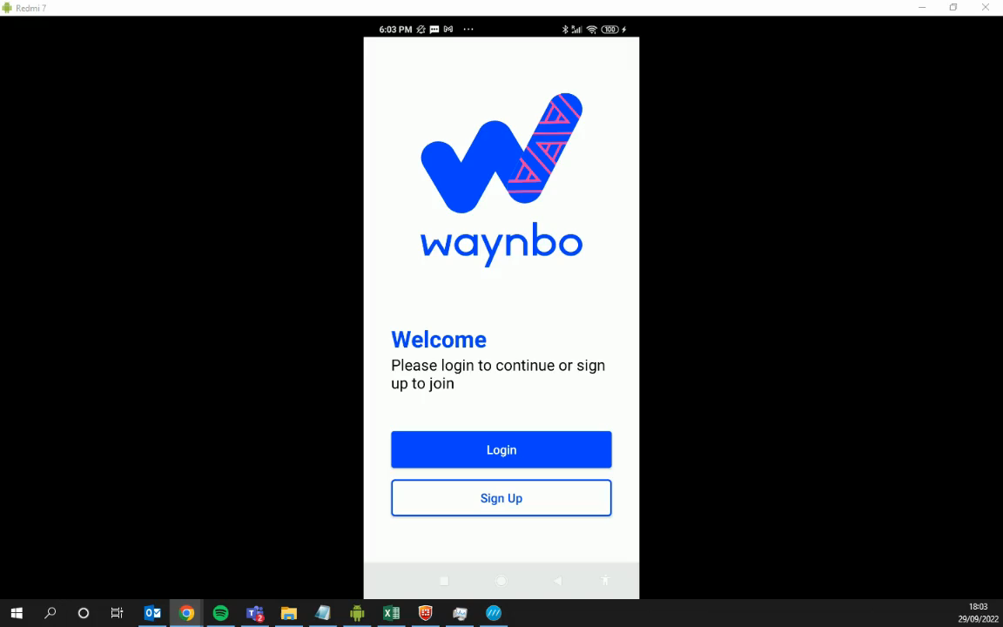
Demo - Customer Initiated Cash-Out

Slide 5
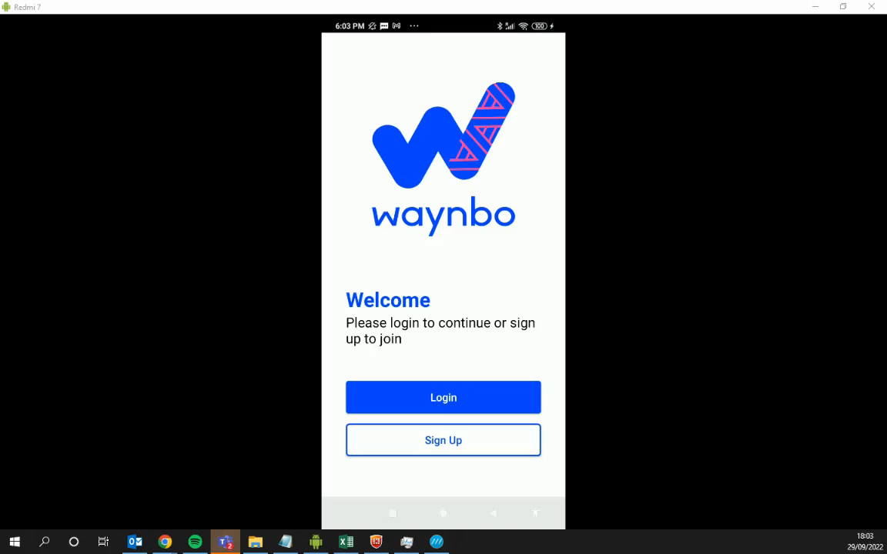
Demo - Agent Initiated Cash-Out

Slide 6
Major concerns to address:
Business Model:
Regulatory framework for CICO
Technology:
Management of pending transactions
Handling of SMS/OTP from each provider (failure rate, time outs, etc)
Setup use case via USSD’s (failure rate, session logs, etc)
System performance for scaling (high volumes, concurrent sessions/transactions, stress tests, etc)

Slide 7
by Papersoft
Thank You!
iago.silva@papersoft-dms.com

